Slide 1

IT시스템엔지니어링기초
4강
2025-07
윤창호

Slide 2
Git
Distributed Version Control System

Slide 3

I. 서버 엔지니어링
텍스트 파일이 하나 있다.
Notes:
https://globenewswire.com/news-release/2017/02/06/914187/0/en/Global-E-Learning-Market-to-Reach-325-billion-by-2025-Rapid-Growth-in-Online-Content-Digitization-Innovations-in-Wearable-Technologies-are-Flourishing-the-E-learning-Industry.html
https://www.gminsights.com/industry-analysis/elearning-market-size

Slide 4

I. 서버 엔지니어링
하고 싶은 것?
수정한 내용을 기록해두고 싶다.
Notes:
https://globenewswire.com/news-release/2017/02/06/914187/0/en/Global-E-Learning-Market-to-Reach-325-billion-by-2025-Rapid-Growth-in-Online-Content-Digitization-Innovations-in-Wearable-Technologies-are-Flourishing-the-E-learning-Industry.html
https://www.gminsights.com/industry-analysis/elearning-market-size

Slide 5
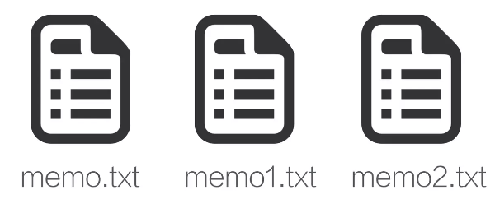
I. 서버 엔지니어링
어떻게 할까?
수정할 때 마다 다른 파일로 저장
Notes:
https://globenewswire.com/news-release/2017/02/06/914187/0/en/Global-E-Learning-Market-to-Reach-325-billion-by-2025-Rapid-Growth-in-Online-Content-Digitization-Innovations-in-Wearable-Technologies-are-Flourishing-the-E-learning-Industry.html
https://www.gminsights.com/industry-analysis/elearning-market-size

Slide 6
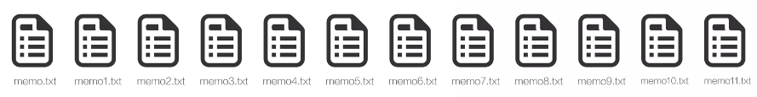
I. 서버 엔지니어링
시간이 지나면
……
Notes:
https://globenewswire.com/news-release/2017/02/06/914187/0/en/Global-E-Learning-Market-to-Reach-325-billion-by-2025-Rapid-Growth-in-Online-Content-Digitization-Innovations-in-Wearable-Technologies-are-Flourishing-the-E-learning-Industry.html
https://www.gminsights.com/industry-analysis/elearning-market-size

Slide 7
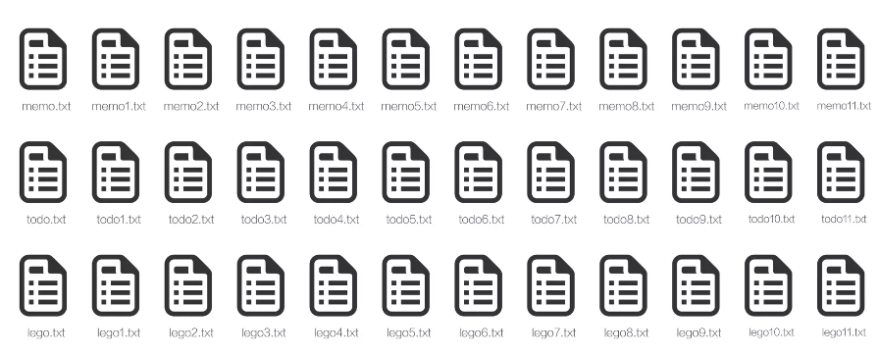
I. 서버 엔지니어링
파일이 하나가 아니라면?
……
Notes:
https://globenewswire.com/news-release/2017/02/06/914187/0/en/Global-E-Learning-Market-to-Reach-325-billion-by-2025-Rapid-Growth-in-Online-Content-Digitization-Innovations-in-Wearable-Technologies-are-Flourishing-the-E-learning-Industry.html
https://www.gminsights.com/industry-analysis/elearning-market-size

Slide 8
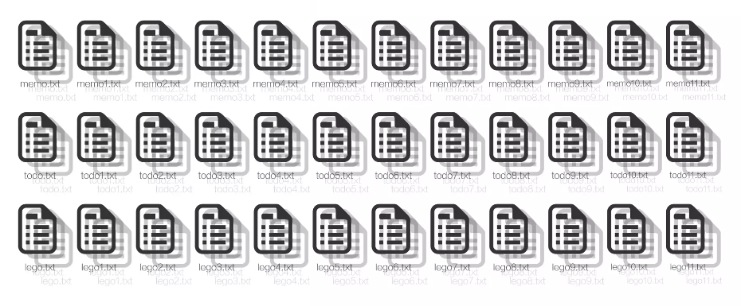
I. 서버 엔지니어링
수정하는 사람이 여러명이면?
……
Notes:
https://globenewswire.com/news-release/2017/02/06/914187/0/en/Global-E-Learning-Market-to-Reach-325-billion-by-2025-Rapid-Growth-in-Online-Content-Digitization-Innovations-in-Wearable-Technologies-are-Flourishing-the-E-learning-Industry.html
https://www.gminsights.com/industry-analysis/elearning-market-size

Slide 9

I. 서버 엔지니어링
폴더로 정리하면 되지 않을까?
이런 생각 하시는 분이 없기를 바랍니다.
Notes:
https://globenewswire.com/news-release/2017/02/06/914187/0/en/Global-E-Learning-Market-to-Reach-325-billion-by-2025-Rapid-Growth-in-Online-Content-Digitization-Innovations-in-Wearable-Technologies-are-Flourishing-the-E-learning-Industry.html
https://www.gminsights.com/industry-analysis/elearning-market-size

Slide 10

I. 서버 엔지니어링
어떻게 할까?
이런일을 전문으로 하는 소프트웨어가 있다? 없다?
Notes:
https://globenewswire.com/news-release/2017/02/06/914187/0/en/Global-E-Learning-Market-to-Reach-325-billion-by-2025-Rapid-Growth-in-Online-Content-Digitization-Innovations-in-Wearable-Technologies-are-Flourishing-the-E-learning-Industry.html
https://www.gminsights.com/industry-analysis/elearning-market-size

Slide 11

I. 서버 엔지니어링
어떤 소프트웨어가 있나?
* SVN: 2000년대 중반까지 널리 쓰임, 2010년 이후 Git에게 지배권을 내어줌
Notes:
https://globenewswire.com/news-release/2017/02/06/914187/0/en/Global-E-Learning-Market-to-Reach-325-billion-by-2025-Rapid-Growth-in-Online-Content-Digitization-Innovations-in-Wearable-Technologies-are-Flourishing-the-E-learning-Industry.html
https://www.gminsights.com/industry-analysis/elearning-market-size

Slide 12

I. 서버 엔지니어링
Git을 배워봅시다. 왜?
분산형 버전 관리, 가장 높은 점유율
* SVN: 2000년대 중반까지 널리 쓰임, 2010년 이후 Git에게 지배권을 내어줌
Notes:
https://globenewswire.com/news-release/2017/02/06/914187/0/en/Global-E-Learning-Market-to-Reach-325-billion-by-2025-Rapid-Growth-in-Online-Content-Digitization-Innovations-in-Wearable-Technologies-are-Flourishing-the-E-learning-Industry.html
https://www.gminsights.com/industry-analysis/elearning-market-size

Slide 13
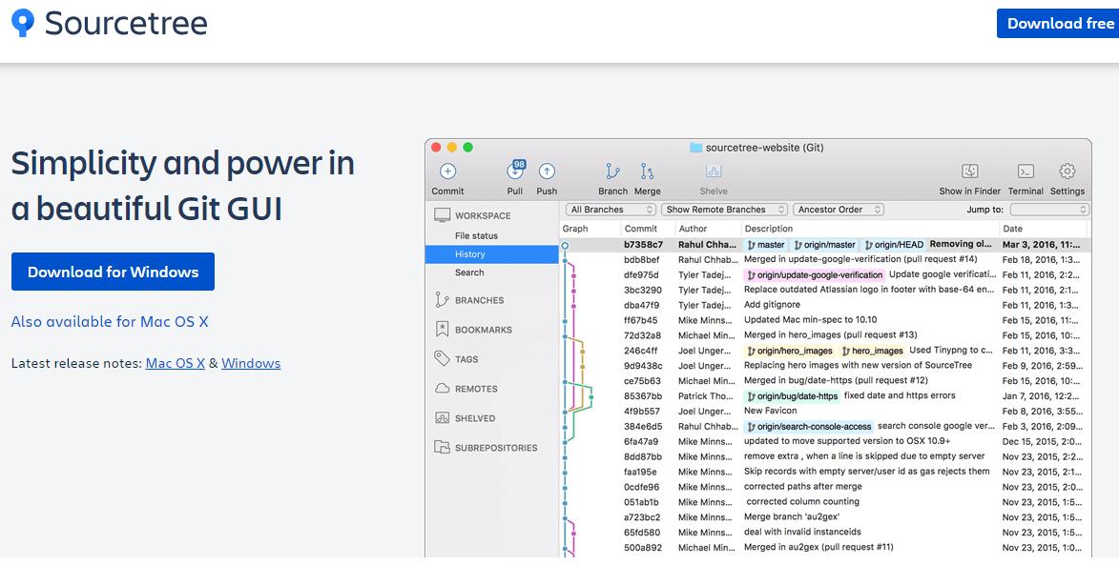
I. 서버 엔지니어링
설치
Git - 간편 안내서
http://rogerdudler.github.io/git-guide/index.ko.html
Ubuntu 22.04
# apt install git
# git --version
Notes:
https://globenewswire.com/news-release/2017/02/06/914187/0/en/Global-E-Learning-Market-to-Reach-325-billion-by-2025-Rapid-Growth-in-Online-Content-Digitization-Innovations-in-Wearable-Technologies-are-Flourishing-the-E-learning-Industry.html
https://www.gminsights.com/industry-analysis/elearning-market-size

Slide 14
실습 준비

Slide 15
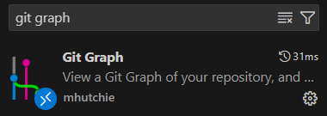
I. 서버 엔지니어링
vscode 준비
1) git graph 설치
Notes:
https://globenewswire.com/news-release/2017/02/06/914187/0/en/Global-E-Learning-Market-to-Reach-325-billion-by-2025-Rapid-Growth-in-Online-Content-Digitization-Innovations-in-Wearable-Technologies-are-Flourishing-the-E-learning-Industry.html
https://www.gminsights.com/industry-analysis/elearning-market-size

Slide 16
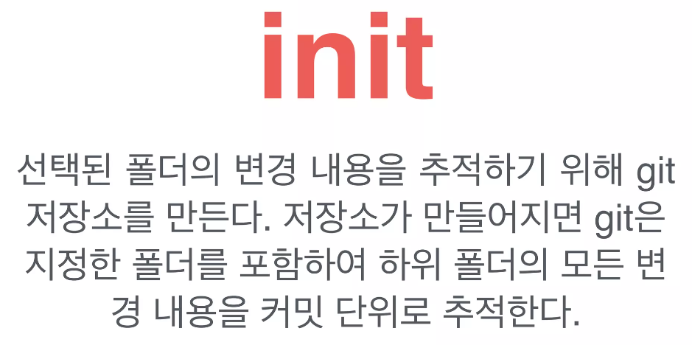
I. 서버 엔지니어링
Git의 시작
지정한 폴더의 변경 내용을 추적하기 위한 준비
Notes:
https://globenewswire.com/news-release/2017/02/06/914187/0/en/Global-E-Learning-Market-to-Reach-325-billion-by-2025-Rapid-Growth-in-Online-Content-Digitization-Innovations-in-Wearable-Technologies-are-Flourishing-the-E-learning-Industry.html
https://www.gminsights.com/industry-analysis/elearning-market-size

Slide 17

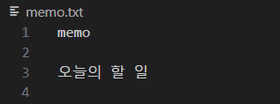
I. 서버 엔지니어링
실습 파일 생성
1) git 초기화
$ git init
$ git config user.name "kopo00"
$ git config user.email kopo00@example.com
$ git config --list
$ touch .gitignore
$ touch memo.txt
$ git status
$ git add -A
$ git commit -m "Initial Commit"
Changes to be committed: 이 영역은 스테이징 영역에 넘어가 있는 변경 내용을 보여줍니다.
Changes not staged for commit: 이 영역은 아직 워킹 디렉토리에 있는 변경 내용을 보여줍니다.
Untracked files: 이 영역도 아직 워킹 디렉토리에 있는 아직 한 번도 해당 Git 저장소가 관리한 적이 없는 새로운 파일을 보여줍니다.
Notes:
https://globenewswire.com/news-release/2017/02/06/914187/0/en/Global-E-Learning-Market-to-Reach-325-billion-by-2025-Rapid-Growth-in-Online-Content-Digitization-Innovations-in-Wearable-Technologies-are-Flourishing-the-E-learning-Industry.html
https://www.gminsights.com/industry-analysis/elearning-market-size

Slide 18
Commit
수정의 단계는 의미

Slide 19
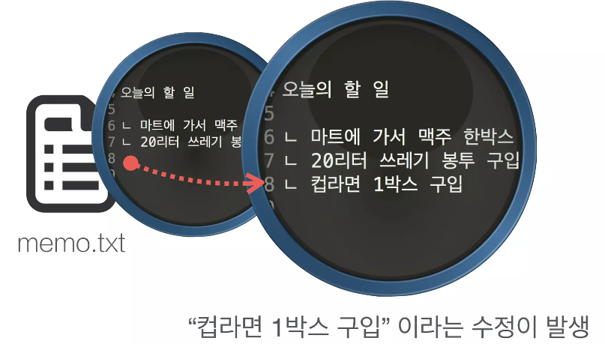
I. 서버 엔지니어링
첫 번째 문제로 돌아가봅시다.
텍스트 파일이 하나 있고,
수정한 내용을 기록해두고 싶다.
Notes:
https://globenewswire.com/news-release/2017/02/06/914187/0/en/Global-E-Learning-Market-to-Reach-325-billion-by-2025-Rapid-Growth-in-Online-Content-Digitization-Innovations-in-Wearable-Technologies-are-Flourishing-the-E-learning-Industry.html
https://www.gminsights.com/industry-analysis/elearning-market-size

Slide 20
I. 서버 엔지니어링
“수정”의 단계를 어느 정도까지 기록해야 할까?
저장할 때 마다?
컵(save)라(save)면(save)… 이런식으로 저장했다해도 모두 기록해야할까?
Notes:
https://globenewswire.com/news-release/2017/02/06/914187/0/en/Global-E-Learning-Market-to-Reach-325-billion-by-2025-Rapid-Growth-in-Online-Content-Digitization-Innovations-in-Wearable-Technologies-are-Flourishing-the-E-learning-Industry.html
https://www.gminsights.com/industry-analysis/elearning-market-size

Slide 21
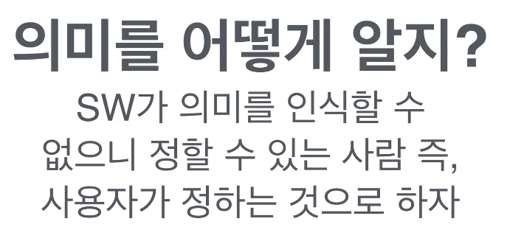
I. 서버 엔지니어링
규칙 1
“수정”의 단계는 “의미＂를 기준으로
Notes:
https://globenewswire.com/news-release/2017/02/06/914187/0/en/Global-E-Learning-Market-to-Reach-325-billion-by-2025-Rapid-Growth-in-Online-Content-Digitization-Innovations-in-Wearable-Technologies-are-Flourishing-the-E-learning-Industry.html
https://www.gminsights.com/industry-analysis/elearning-market-size

Slide 22
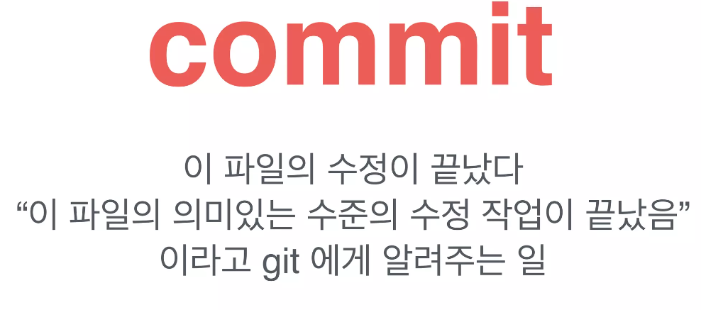
I. 서버 엔지니어링
규칙 1
“수정”의 단계는 “의미＂를 기준으로
Notes:
https://globenewswire.com/news-release/2017/02/06/914187/0/en/Global-E-Learning-Market-to-Reach-325-billion-by-2025-Rapid-Growth-in-Online-Content-Digitization-Innovations-in-Wearable-Technologies-are-Flourishing-the-E-learning-Industry.html
https://www.gminsights.com/industry-analysis/elearning-market-size

Slide 23
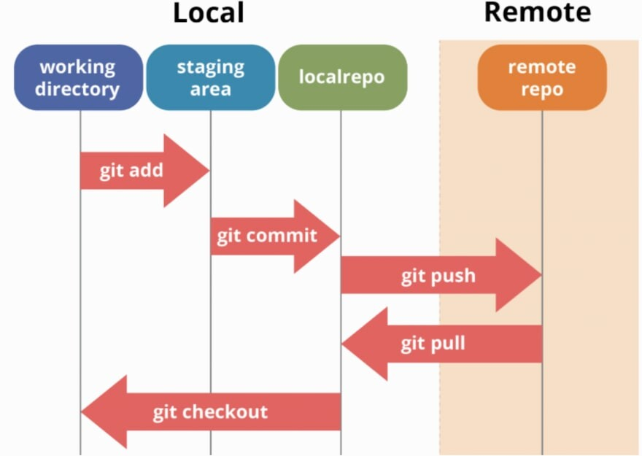
I. 서버 엔지니어링
add & commit
$ echo "- 마트에 가서 맥주 한박스" >> memo.txt
$ git add -A
$ git commit -m "맥주 구매 할 일 추가"
$ echo "- 20리터 쓰레기 봉투 구입" >> memo.txt
$ git add -A
$ git commit -m "쓰레기 봉투 구매 할 일 추가 "
$ echo "- 컵라면 1박스 구입" >> memo.txt
$ git add -A
$ git commit -m "컵라면 구매 할 일 추가"
Notes:
https://globenewswire.com/news-release/2017/02/06/914187/0/en/Global-E-Learning-Market-to-Reach-325-billion-by-2025-Rapid-Growth-in-Online-Content-Digitization-Innovations-in-Wearable-Technologies-are-Flourishing-the-E-learning-Industry.html
https://www.gminsights.com/industry-analysis/elearning-market-size

Slide 24
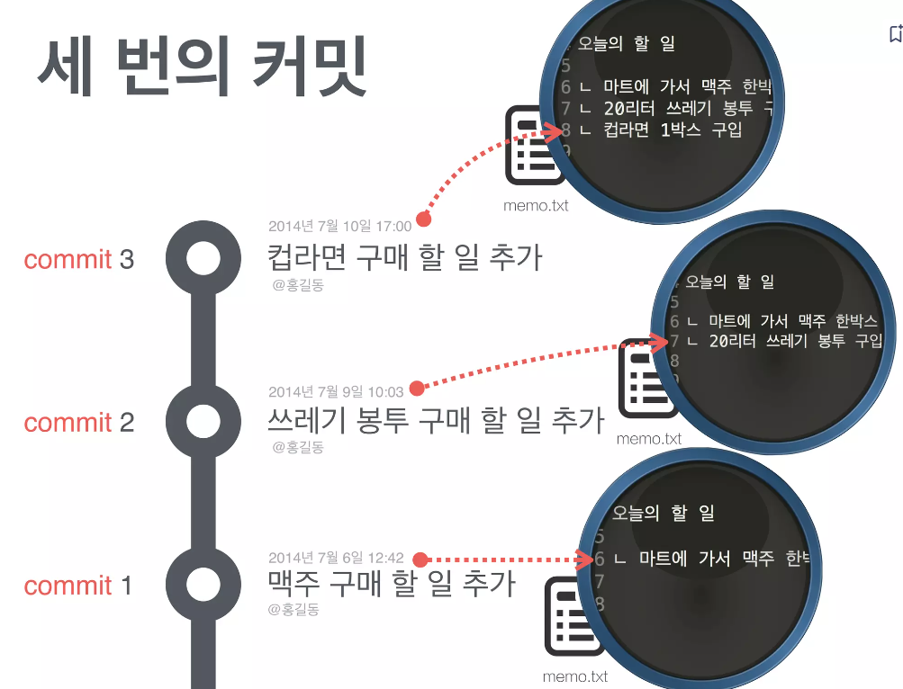
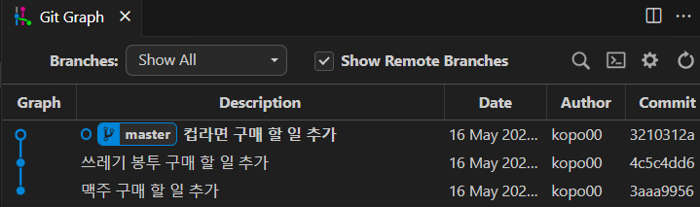
I. 서버 엔지니어링
세 번의 커밋
Notes:
https://globenewswire.com/news-release/2017/02/06/914187/0/en/Global-E-Learning-Market-to-Reach-325-billion-by-2025-Rapid-Growth-in-Online-Content-Digitization-Innovations-in-Wearable-Technologies-are-Flourishing-the-E-learning-Industry.html
https://www.gminsights.com/industry-analysis/elearning-market-size

Slide 25
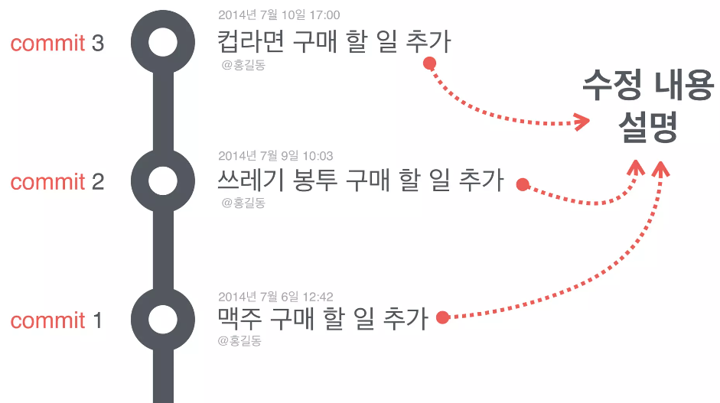
I. 서버 엔지니어링
수정한 내용을 간략하게 표현하기 위한
“커밋 메세지“ 기록
Notes:
https://globenewswire.com/news-release/2017/02/06/914187/0/en/Global-E-Learning-Market-to-Reach-325-billion-by-2025-Rapid-Growth-in-Online-Content-Digitization-Innovations-in-Wearable-Technologies-are-Flourishing-the-E-learning-Industry.html
https://www.gminsights.com/industry-analysis/elearning-market-size

Slide 26
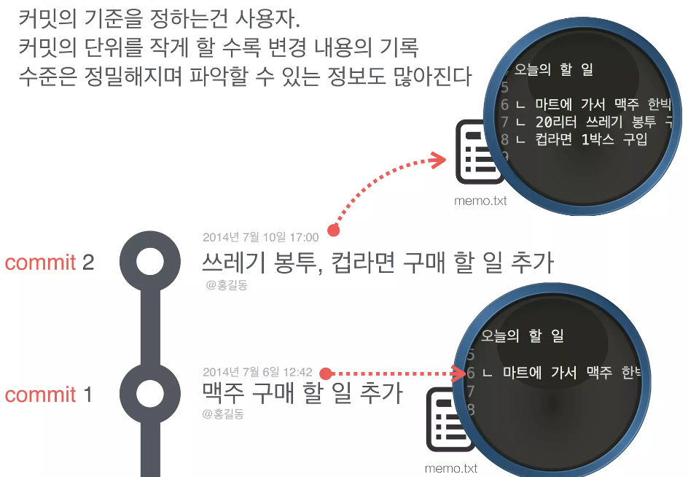
I. 서버 엔지니어링
두 번만 할 수도 있겠죠?
Notes:
https://globenewswire.com/news-release/2017/02/06/914187/0/en/Global-E-Learning-Market-to-Reach-325-billion-by-2025-Rapid-Growth-in-Online-Content-Digitization-Innovations-in-Wearable-Technologies-are-Flourishing-the-E-learning-Industry.html
https://www.gminsights.com/industry-analysis/elearning-market-size

Slide 27
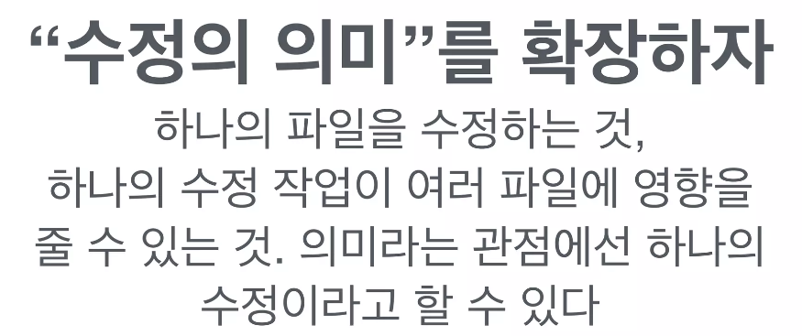
I. 서버 엔지니어링
규칙 2
하나의 커밋(Commit)은 여러 개의 파일이 포함될 수 있다.
Notes:
https://globenewswire.com/news-release/2017/02/06/914187/0/en/Global-E-Learning-Market-to-Reach-325-billion-by-2025-Rapid-Growth-in-Online-Content-Digitization-Innovations-in-Wearable-Technologies-are-Flourishing-the-E-learning-Industry.html
https://www.gminsights.com/industry-analysis/elearning-market-size

Slide 28
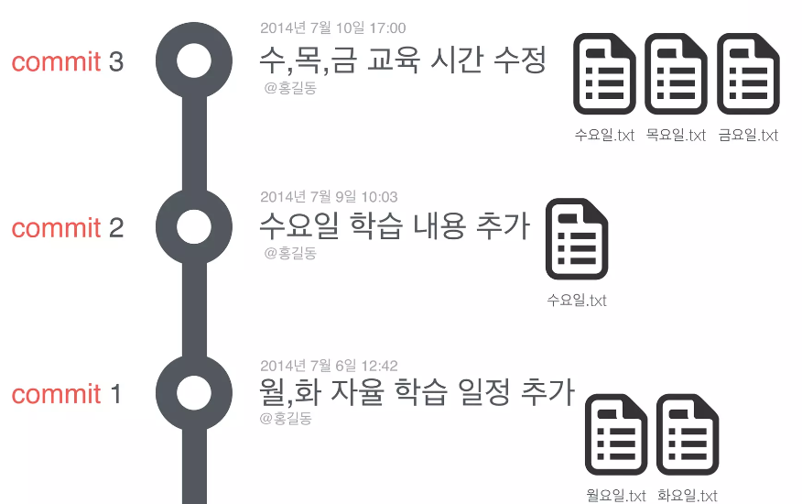
I. 서버 엔지니어링
커밋은 수정의 단위. 수정은 여러 파일에 걸친
변경 내역의 묶음일 수 있다.
Notes:
https://globenewswire.com/news-release/2017/02/06/914187/0/en/Global-E-Learning-Market-to-Reach-325-billion-by-2025-Rapid-Growth-in-Online-Content-Digitization-Innovations-in-Wearable-Technologies-are-Flourishing-the-E-learning-Industry.html
https://www.gminsights.com/industry-analysis/elearning-market-size

Slide 29
I. 서버 엔지니어링
아무거나 변경 후 commit 5회 수행
Notes:
https://globenewswire.com/news-release/2017/02/06/914187/0/en/Global-E-Learning-Market-to-Reach-325-billion-by-2025-Rapid-Growth-in-Online-Content-Digitization-Innovations-in-Wearable-Technologies-are-Flourishing-the-E-learning-Industry.html
https://www.gminsights.com/industry-analysis/elearning-market-size

Slide 30
Branch
상태를 저장하는 공간

Slide 31
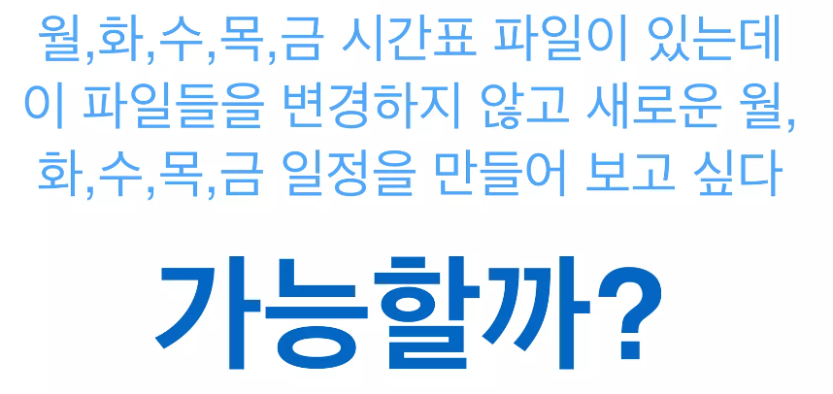
I. 서버 엔지니어링
파일을 수정하지 않고
새로운 실험을 해 볼 순 없을까?
Notes:
https://globenewswire.com/news-release/2017/02/06/914187/0/en/Global-E-Learning-Market-to-Reach-325-billion-by-2025-Rapid-Growth-in-Online-Content-Digitization-Innovations-in-Wearable-Technologies-are-Flourishing-the-E-learning-Industry.html
https://www.gminsights.com/industry-analysis/elearning-market-size

Slide 32
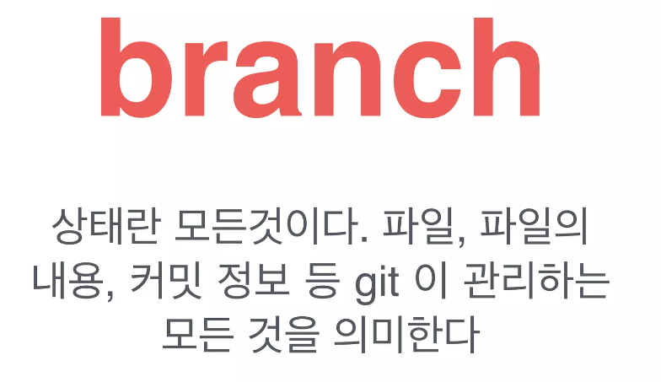
I. 서버 엔지니어링
규칙 3
상태를 저장하는 공간을 만들 수 있다.
Notes:
https://globenewswire.com/news-release/2017/02/06/914187/0/en/Global-E-Learning-Market-to-Reach-325-billion-by-2025-Rapid-Growth-in-Online-Content-Digitization-Innovations-in-Wearable-Technologies-are-Flourishing-the-E-learning-Industry.html
https://www.gminsights.com/industry-analysis/elearning-market-size

Slide 33
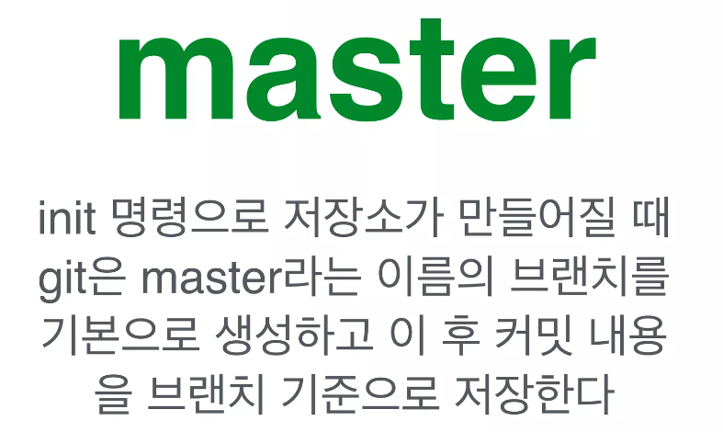
I. 서버 엔지니어링
기본 브랜치
master
Notes:
https://globenewswire.com/news-release/2017/02/06/914187/0/en/Global-E-Learning-Market-to-Reach-325-billion-by-2025-Rapid-Growth-in-Online-Content-Digitization-Innovations-in-Wearable-Technologies-are-Flourishing-the-E-learning-Industry.html
https://www.gminsights.com/industry-analysis/elearning-market-size

Slide 34
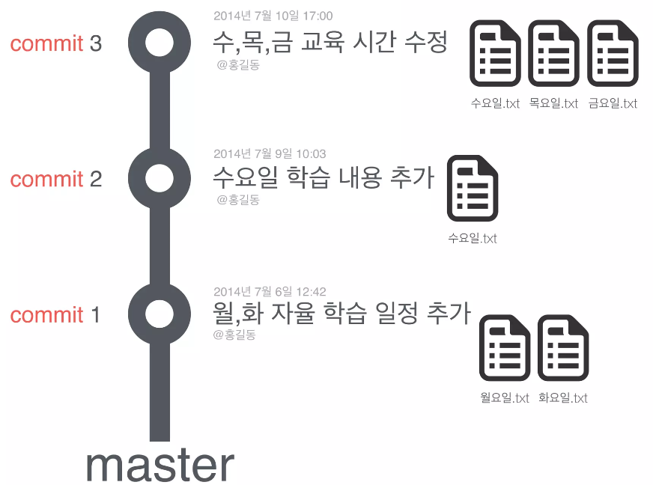
I. 서버 엔지니어링
커밋은 브랜치 공간에 기록된다.
Notes:
https://globenewswire.com/news-release/2017/02/06/914187/0/en/Global-E-Learning-Market-to-Reach-325-billion-by-2025-Rapid-Growth-in-Online-Content-Digitization-Innovations-in-Wearable-Technologies-are-Flourishing-the-E-learning-Industry.html
https://www.gminsights.com/industry-analysis/elearning-market-size

Slide 35
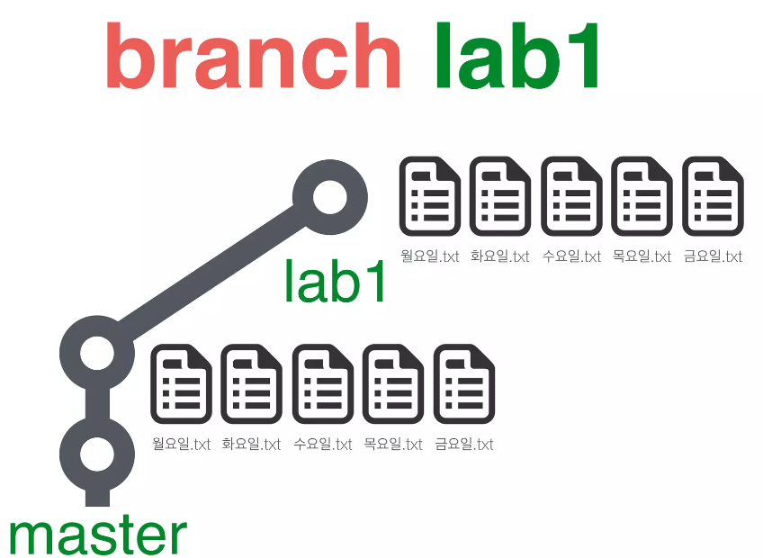
I. 서버 엔지니어링
새로운 브랜치 만들기
파일을 수정하지 않고 새로운 실험 하기
Notes:
https://globenewswire.com/news-release/2017/02/06/914187/0/en/Global-E-Learning-Market-to-Reach-325-billion-by-2025-Rapid-Growth-in-Online-Content-Digitization-Innovations-in-Wearable-Technologies-are-Flourishing-the-E-learning-Industry.html
https://www.gminsights.com/industry-analysis/elearning-market-size

Slide 36
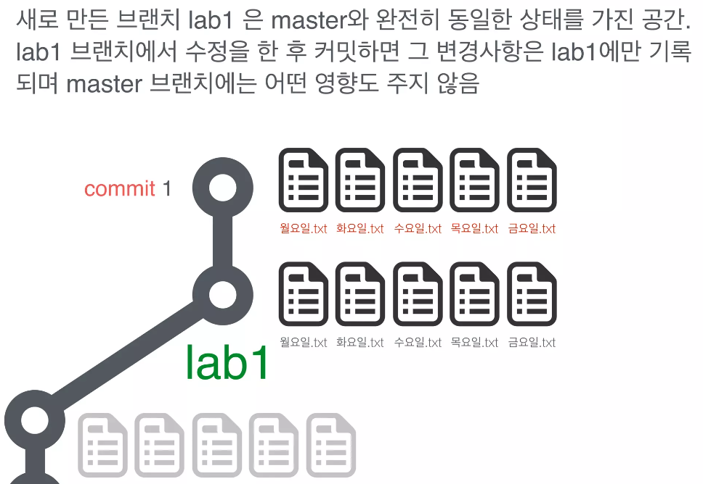
I. 서버 엔지니어링
완전히 독립된 브랜치 lab1
Notes:
https://globenewswire.com/news-release/2017/02/06/914187/0/en/Global-E-Learning-Market-to-Reach-325-billion-by-2025-Rapid-Growth-in-Online-Content-Digitization-Innovations-in-Wearable-Technologies-are-Flourishing-the-E-learning-Industry.html
https://www.gminsights.com/industry-analysis/elearning-market-size

Slide 37
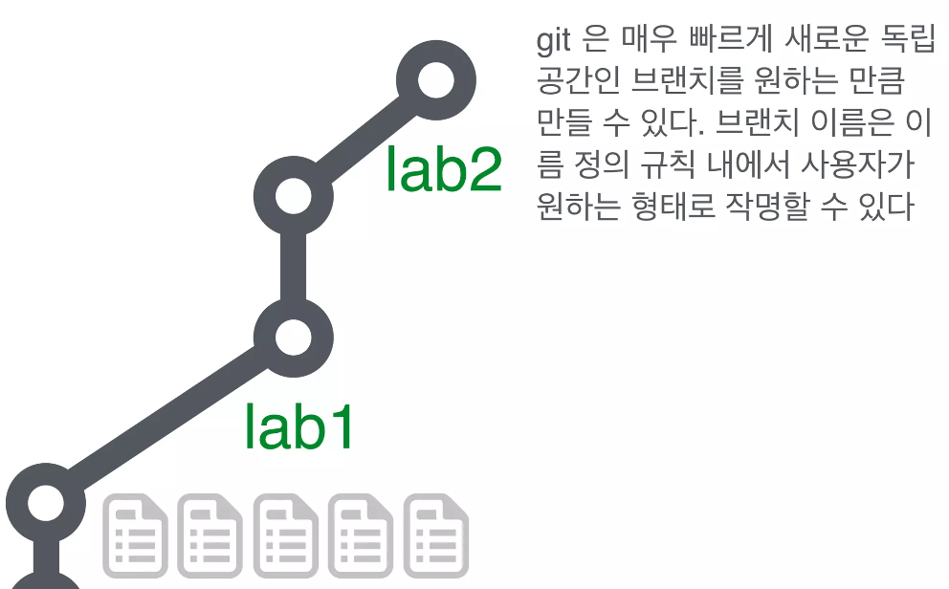
I. 서버 엔지니어링
원하는 만큼 브랜치 생성 가능
Notes:
https://globenewswire.com/news-release/2017/02/06/914187/0/en/Global-E-Learning-Market-to-Reach-325-billion-by-2025-Rapid-Growth-in-Online-Content-Digitization-Innovations-in-Wearable-Technologies-are-Flourishing-the-E-learning-Industry.html
https://www.gminsights.com/industry-analysis/elearning-market-size

Slide 38
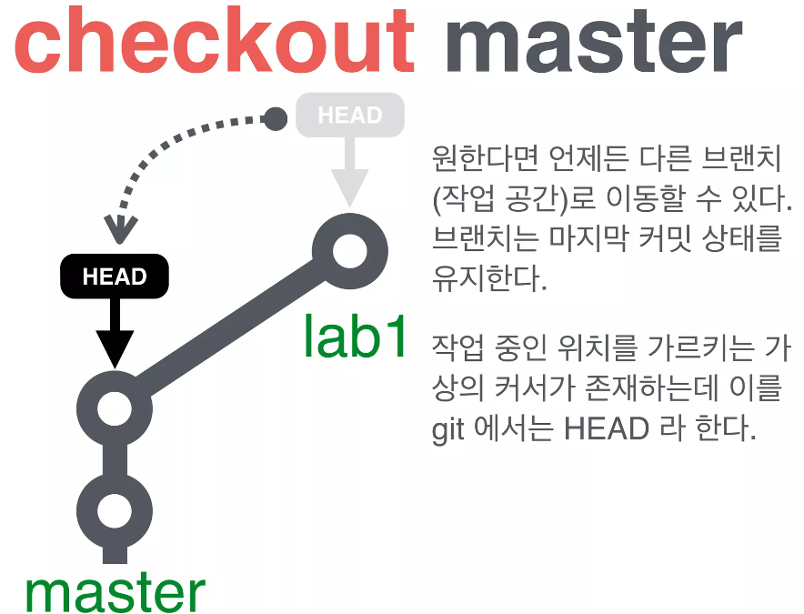
I. 서버 엔지니어링
실험 중 다른 브랜치로 돌아가야한다면?
Notes:
https://globenewswire.com/news-release/2017/02/06/914187/0/en/Global-E-Learning-Market-to-Reach-325-billion-by-2025-Rapid-Growth-in-Online-Content-Digitization-Innovations-in-Wearable-Technologies-are-Flourishing-the-E-learning-Industry.html
https://www.gminsights.com/industry-analysis/elearning-market-size

Slide 39

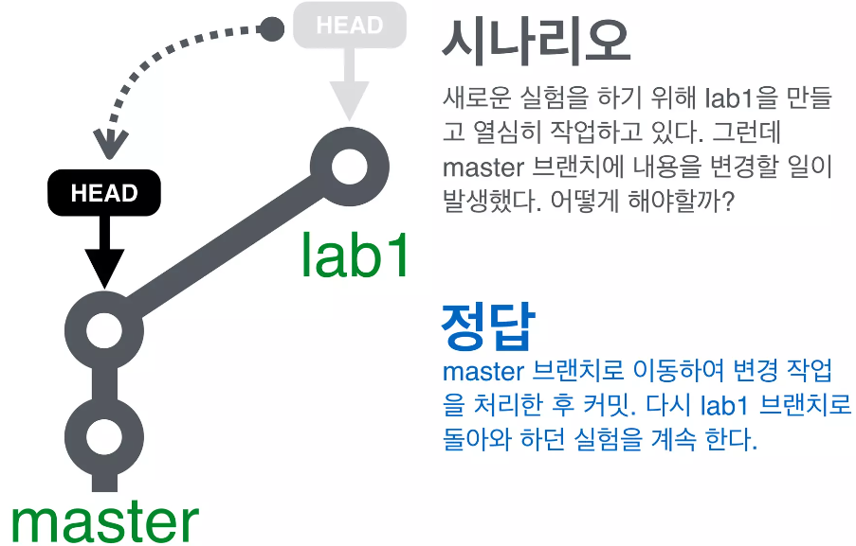
I. 서버 엔지니어링
Notes:
https://globenewswire.com/news-release/2017/02/06/914187/0/en/Global-E-Learning-Market-to-Reach-325-billion-by-2025-Rapid-Growth-in-Online-Content-Digitization-Innovations-in-Wearable-Technologies-are-Flourishing-the-E-learning-Industry.html
https://www.gminsights.com/industry-analysis/elearning-market-size

Slide 40
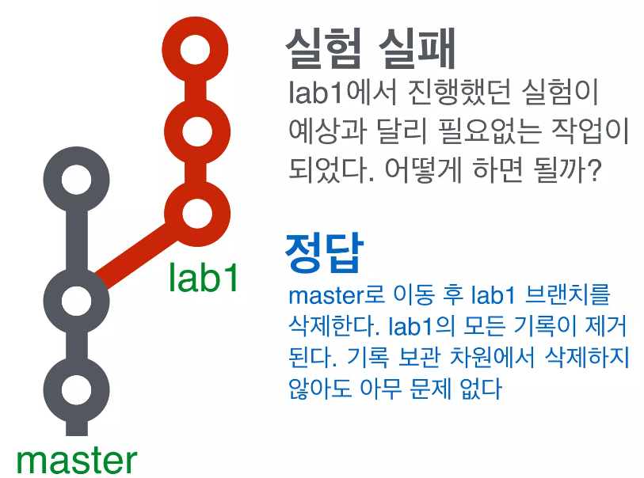
I. 서버 엔지니어링
실험 종료. 선택의 순간
Notes:
https://globenewswire.com/news-release/2017/02/06/914187/0/en/Global-E-Learning-Market-to-Reach-325-billion-by-2025-Rapid-Growth-in-Online-Content-Digitization-Innovations-in-Wearable-Technologies-are-Flourishing-the-E-learning-Industry.html
https://www.gminsights.com/industry-analysis/elearning-market-size

Slide 41
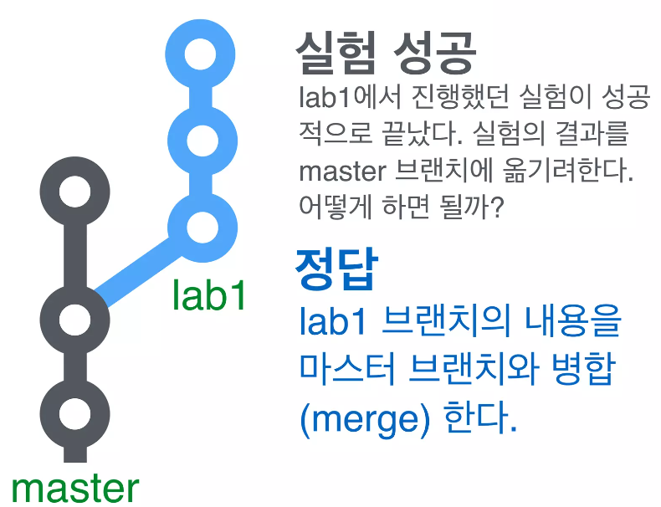
I. 서버 엔지니어링
실험 종료. 선택의 순간
Notes:
https://globenewswire.com/news-release/2017/02/06/914187/0/en/Global-E-Learning-Market-to-Reach-325-billion-by-2025-Rapid-Growth-in-Online-Content-Digitization-Innovations-in-Wearable-Technologies-are-Flourishing-the-E-learning-Industry.html
https://www.gminsights.com/industry-analysis/elearning-market-size

Slide 42
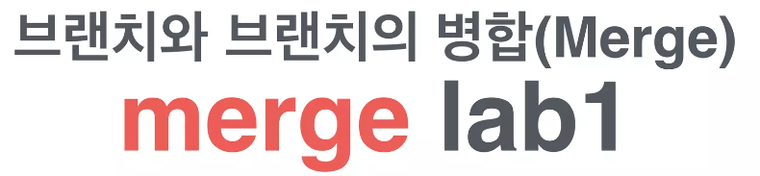
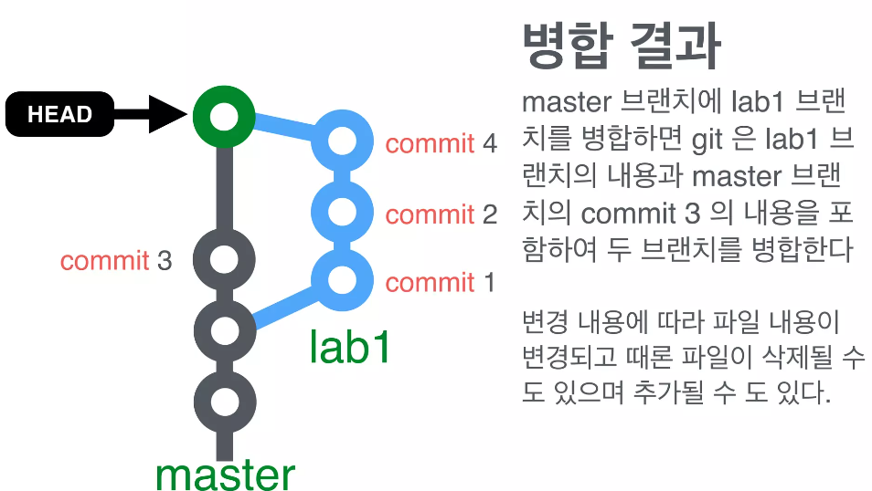
I. 서버 엔지니어링
Notes:
https://globenewswire.com/news-release/2017/02/06/914187/0/en/Global-E-Learning-Market-to-Reach-325-billion-by-2025-Rapid-Growth-in-Online-Content-Digitization-Innovations-in-Wearable-Technologies-are-Flourishing-the-E-learning-Industry.html
https://www.gminsights.com/industry-analysis/elearning-market-size

Slide 43
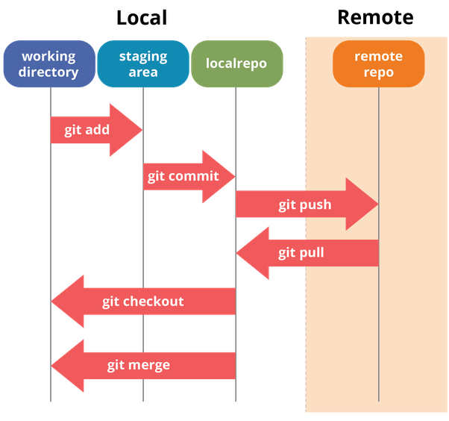
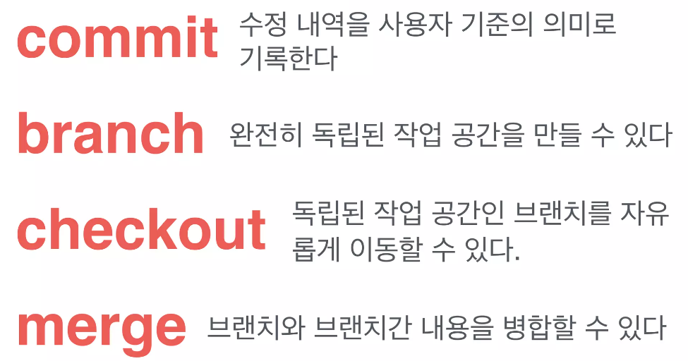
I. 서버 엔지니어링
정리
Notes:
https://globenewswire.com/news-release/2017/02/06/914187/0/en/Global-E-Learning-Market-to-Reach-325-billion-by-2025-Rapid-Growth-in-Online-Content-Digitization-Innovations-in-Wearable-Technologies-are-Flourishing-the-E-learning-Industry.html
https://www.gminsights.com/industry-analysis/elearning-market-size

Slide 44
I. 서버 엔지니어링
branch & checkout
$ git branch develop master (develop 브랜치 생성)
$ git checkout develop (develop로 브랜치 이동)
$ git checkout master
$ git branch -d develop (develop 브랜치 삭제)
$ git checkout -b develop (branch 생성, checkout 한번에)
$ … commit N번
$ git checkout master
$ … commit N번
$ git merge develop
Notes:
https://globenewswire.com/news-release/2017/02/06/914187/0/en/Global-E-Learning-Market-to-Reach-325-billion-by-2025-Rapid-Growth-in-Online-Content-Digitization-Innovations-in-Wearable-Technologies-are-Flourishing-the-E-learning-Industry.html
https://www.gminsights.com/industry-analysis/elearning-market-size

Slide 45
Clone, Push, Pull, Fetch
협업

Slide 46
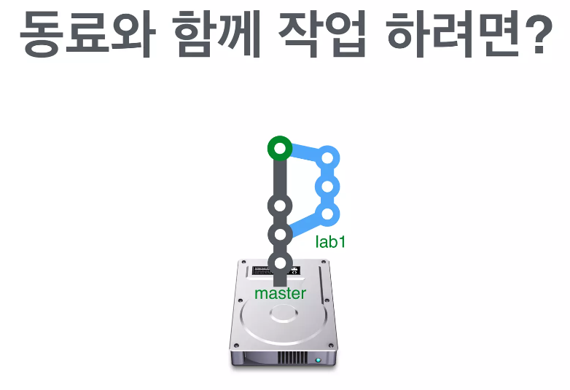
I. 서버 엔지니어링
어떻게 다른 사람과 함께 작업할 수 있을까?
우리는 git 저장소를 하나 가지고 있다.
내 컴퓨터에 있기 때문에 나만 접근할 수 있다.
Notes:
https://globenewswire.com/news-release/2017/02/06/914187/0/en/Global-E-Learning-Market-to-Reach-325-billion-by-2025-Rapid-Growth-in-Online-Content-Digitization-Innovations-in-Wearable-Technologies-are-Flourishing-the-E-learning-Industry.html
https://www.gminsights.com/industry-analysis/elearning-market-size

Slide 47
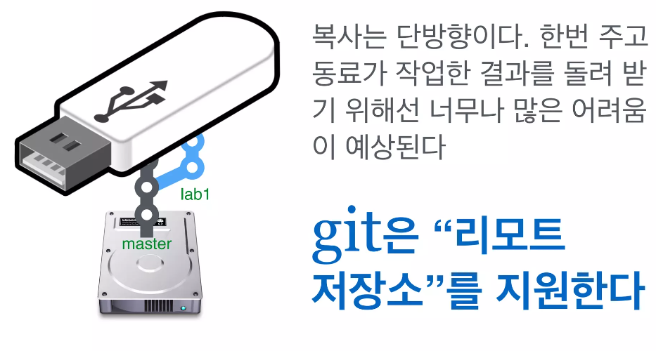
I. 서버 엔지니어링
복사를 시도해 볼 수 있겠다.
Notes:
https://globenewswire.com/news-release/2017/02/06/914187/0/en/Global-E-Learning-Market-to-Reach-325-billion-by-2025-Rapid-Growth-in-Online-Content-Digitization-Innovations-in-Wearable-Technologies-are-Flourishing-the-E-learning-Industry.html
https://www.gminsights.com/industry-analysis/elearning-market-size

Slide 48
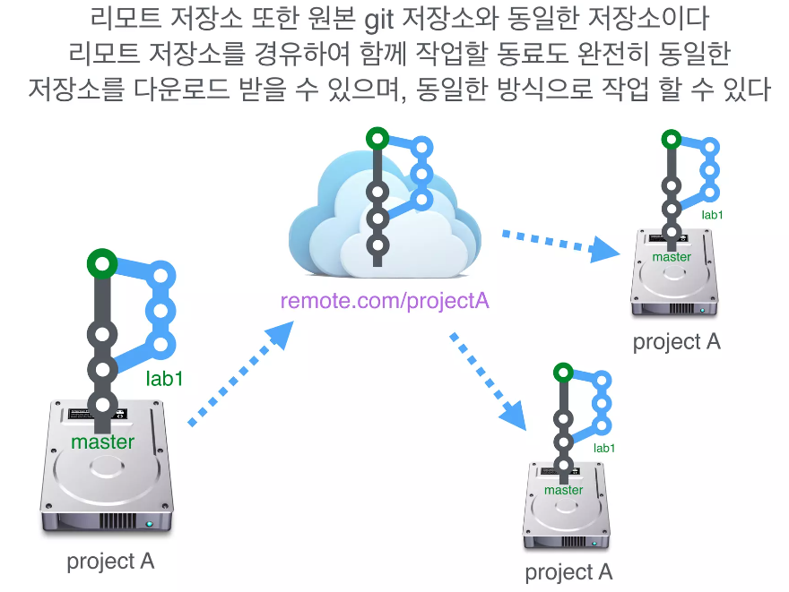
I. 서버 엔지니어링
리모트 저장소가 있다면?
Notes:
https://globenewswire.com/news-release/2017/02/06/914187/0/en/Global-E-Learning-Market-to-Reach-325-billion-by-2025-Rapid-Growth-in-Online-Content-Digitization-Innovations-in-Wearable-Technologies-are-Flourishing-the-E-learning-Industry.html
https://www.gminsights.com/industry-analysis/elearning-market-size

Slide 49
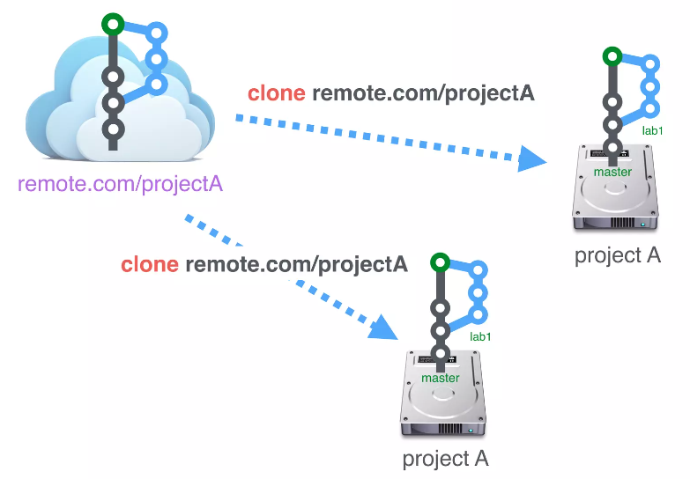
I. 서버 엔지니어링
리모트 저장소에서 저장소 다운로드
리모트 저장소에서 처음으로 git 저장소를 다운로드 받는 것을
복사본을 만든다는 의미로 clone 이라 한다.
Notes:
https://globenewswire.com/news-release/2017/02/06/914187/0/en/Global-E-Learning-Market-to-Reach-325-billion-by-2025-Rapid-Growth-in-Online-Content-Digitization-Innovations-in-Wearable-Technologies-are-Flourishing-the-E-learning-Industry.html
https://www.gminsights.com/industry-analysis/elearning-market-size

Slide 50
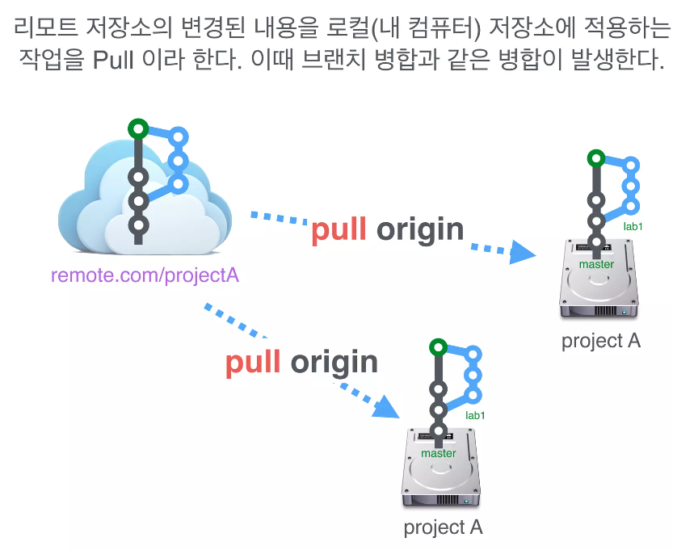
I. 서버 엔지니어링
리모트 저장소의 변경 내용 업데이트
Notes:
https://globenewswire.com/news-release/2017/02/06/914187/0/en/Global-E-Learning-Market-to-Reach-325-billion-by-2025-Rapid-Growth-in-Online-Content-Digitization-Innovations-in-Wearable-Technologies-are-Flourishing-the-E-learning-Industry.html
https://www.gminsights.com/industry-analysis/elearning-market-size

Slide 51
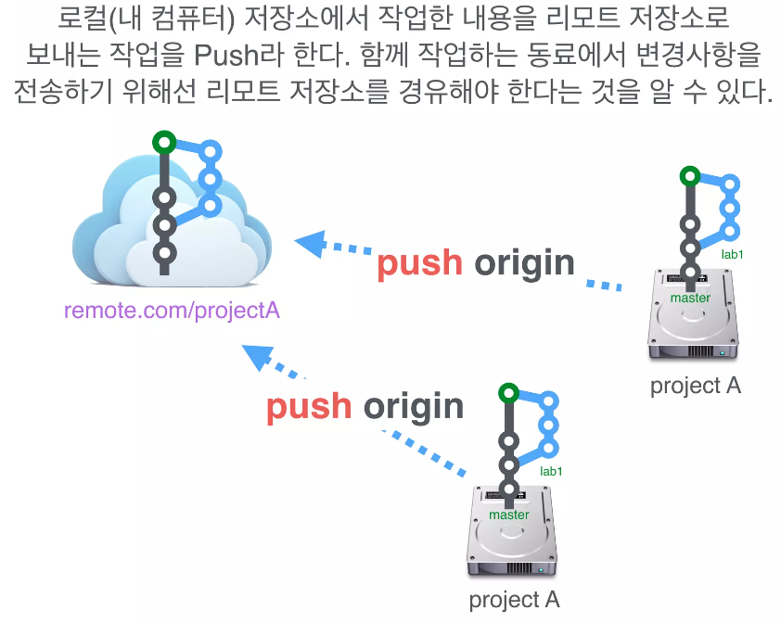
I. 서버 엔지니어링
내 저장소(로컬 저장소)의 변경 내용 리모트로 전송하기
Notes:
https://globenewswire.com/news-release/2017/02/06/914187/0/en/Global-E-Learning-Market-to-Reach-325-billion-by-2025-Rapid-Growth-in-Online-Content-Digitization-Innovations-in-Wearable-Technologies-are-Flourishing-the-E-learning-Industry.html
https://www.gminsights.com/industry-analysis/elearning-market-size

Slide 52
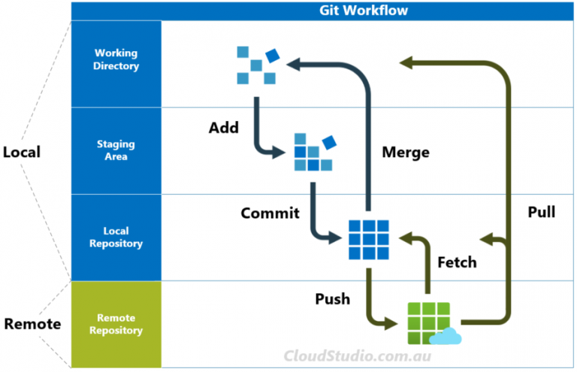
I. 서버 엔지니어링
fetch: 메타데이터만 로컬 저장소로 받음
git fetch –all
git reset –hard origin/develop
Notes:
https://globenewswire.com/news-release/2017/02/06/914187/0/en/Global-E-Learning-Market-to-Reach-325-billion-by-2025-Rapid-Growth-in-Online-Content-Digitization-Innovations-in-Wearable-Technologies-are-Flourishing-the-E-learning-Industry.html
https://www.gminsights.com/industry-analysis/elearning-market-size

Slide 53


I. 서버 엔지니어링
리모트 저장소를 쉽게 만들고
공유할 수 있는 대표적인 서비스가 있다.
Notes:
https://globenewswire.com/news-release/2017/02/06/914187/0/en/Global-E-Learning-Market-to-Reach-325-billion-by-2025-Rapid-Growth-in-Online-Content-Digitization-Innovations-in-Wearable-Technologies-are-Flourishing-the-E-learning-Industry.html
https://www.gminsights.com/industry-analysis/elearning-market-size

Slide 54
Gitlab 설치

Slide 55
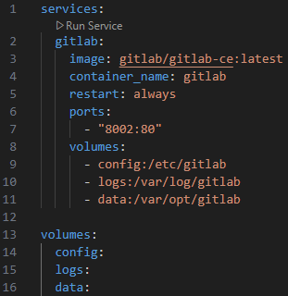
I. 서버 엔지니어링
gitlab 설치
host$ mkdir ~/gitlab && cd ~/gitlab
host$ vi docker-compose.yml
host$ docker-compose logs gitlab -f
브라우저에서 접속
회원가입 및 프로젝트 생성
Notes:
https://globenewswire.com/news-release/2017/02/06/914187/0/en/Global-E-Learning-Market-to-Reach-325-billion-by-2025-Rapid-Growth-in-Online-Content-Digitization-Innovations-in-Wearable-Technologies-are-Flourishing-the-E-learning-Industry.html
https://www.gminsights.com/industry-analysis/elearning-market-size

Slide 56
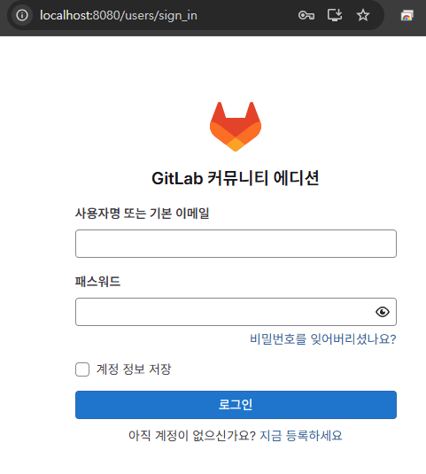
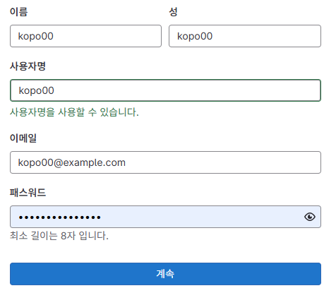
I. 서버 엔지니어링
private gitlab 접속
http://localhost:8002/
관리자 비번 확인(id: root)
# docker exec -it gitlab grep 'Password:' /etc/gitlab/initial_root_password
관리자로 로그인 후 admin dashboard에서 회원가입 승인
Notes:
https://globenewswire.com/news-release/2017/02/06/914187/0/en/Global-E-Learning-Market-to-Reach-325-billion-by-2025-Rapid-Growth-in-Online-Content-Digitization-Innovations-in-Wearable-Technologies-are-Flourishing-the-E-learning-Industry.html
https://www.gminsights.com/industry-analysis/elearning-market-size

Slide 57
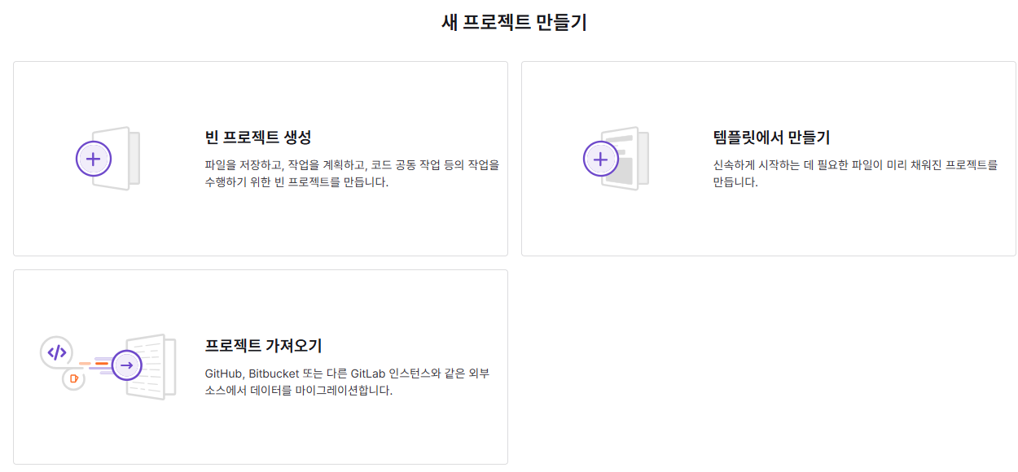
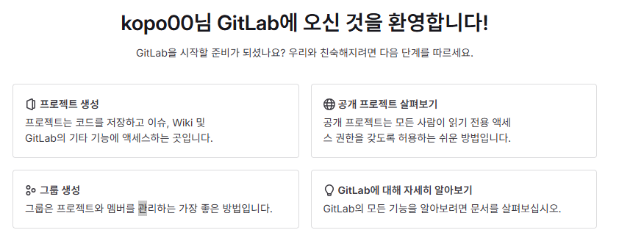
I. 서버 엔지니어링
프로젝트 생성
Notes:
https://globenewswire.com/news-release/2017/02/06/914187/0/en/Global-E-Learning-Market-to-Reach-325-billion-by-2025-Rapid-Growth-in-Online-Content-Digitization-Innovations-in-Wearable-Technologies-are-Flourishing-the-E-learning-Industry.html
https://www.gminsights.com/industry-analysis/elearning-market-size

Slide 58
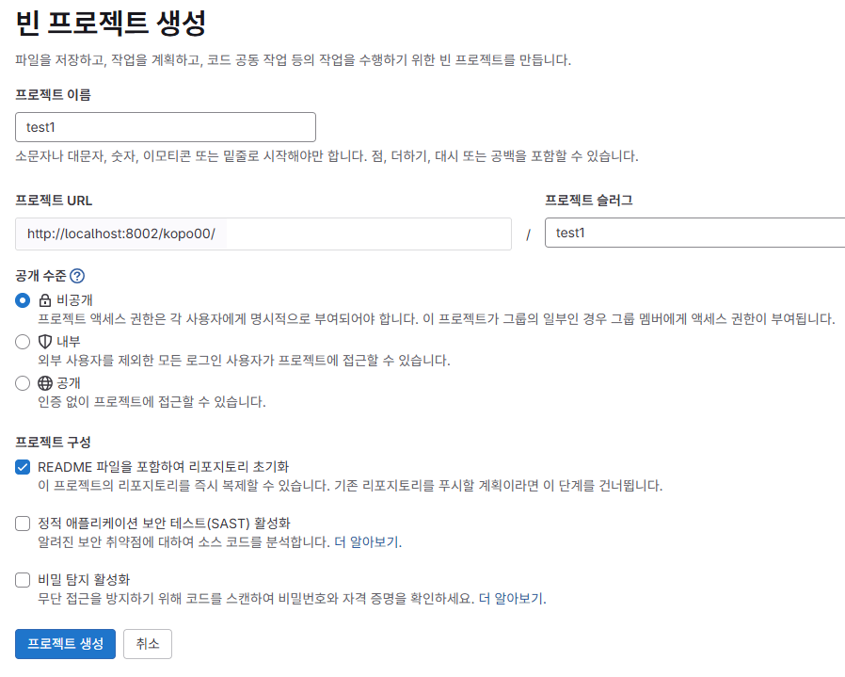
I. 서버 엔지니어링
프로젝트 생성
Notes:
https://globenewswire.com/news-release/2017/02/06/914187/0/en/Global-E-Learning-Market-to-Reach-325-billion-by-2025-Rapid-Growth-in-Online-Content-Digitization-Innovations-in-Wearable-Technologies-are-Flourishing-the-E-learning-Industry.html
https://www.gminsights.com/industry-analysis/elearning-market-size

Slide 59
I. 서버 엔지니어링
push
host$ cd ~/gitlab
host$ git clone http://localhost:8002/kopo00/test1.git
host$ cd test1
host$ git config user.name "kopo00"
host$ git config user.email kopo00@example.com
host$ git config --global credential.helper store
host$ git push --set-upstream origin --all
host$ code
스프링 프로젝트 복제
Notes:
https://globenewswire.com/news-release/2017/02/06/914187/0/en/Global-E-Learning-Market-to-Reach-325-billion-by-2025-Rapid-Growth-in-Online-Content-Digitization-Innovations-in-Wearable-Technologies-are-Flourishing-the-E-learning-Industry.html
https://www.gminsights.com/industry-analysis/elearning-market-size

Slide 60
Merge, Rebase, Reset
…

Slide 61
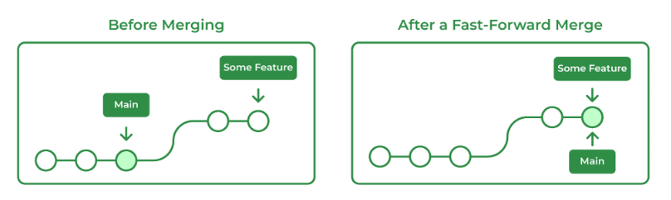
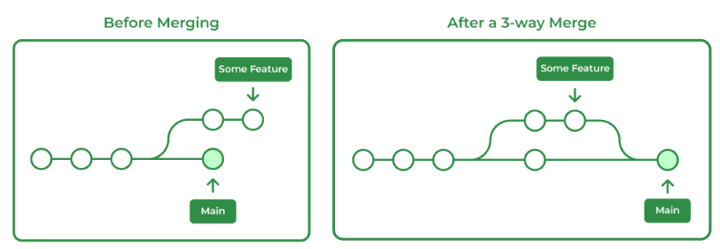
I. 서버 엔지니어링
merge
Fast-Forward Merging
Three-Way Merging
1. Fast-Forward Merging
$ git checkout develop
$ … commit N번
$ git checkout master
$ git merge develop
2. Three-Way Merging
$ git checkout develop
$ … commit N번
$ git checkout master
$ … commit N번
$ git merge develop
Notes:
https://globenewswire.com/news-release/2017/02/06/914187/0/en/Global-E-Learning-Market-to-Reach-325-billion-by-2025-Rapid-Growth-in-Online-Content-Digitization-Innovations-in-Wearable-Technologies-are-Flourishing-the-E-learning-Industry.html
https://www.gminsights.com/industry-analysis/elearning-market-size

Slide 62
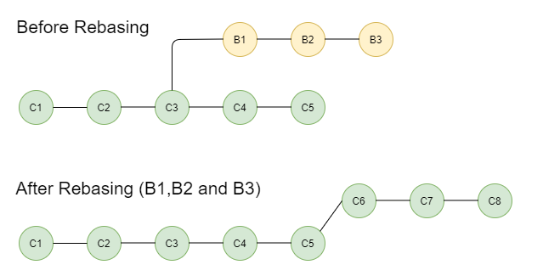
I. 서버 엔지니어링
rebase
$ git checkout master
$ … commit N번
$ git checkout develop
$ … commit N번
$ git rebase master
Notes:
https://globenewswire.com/news-release/2017/02/06/914187/0/en/Global-E-Learning-Market-to-Reach-325-billion-by-2025-Rapid-Growth-in-Online-Content-Digitization-Innovations-in-Wearable-Technologies-are-Flourishing-the-E-learning-Industry.html
https://www.gminsights.com/industry-analysis/elearning-market-size

Slide 63
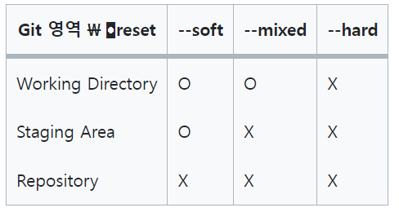
I. 서버 엔지니어링
reset
$ git checkout develop
$ … commit N번
$ git reset --soft [commit ID or branch]
$ git reset --mixed [commit ID or branch]
$ git reset --hard [commit ID or branch]
Notes:
https://globenewswire.com/news-release/2017/02/06/914187/0/en/Global-E-Learning-Market-to-Reach-325-billion-by-2025-Rapid-Growth-in-Online-Content-Digitization-Innovations-in-Wearable-Technologies-are-Flourishing-the-E-learning-Industry.html
https://www.gminsights.com/industry-analysis/elearning-market-size

Slide 64
기타
…

Slide 65


I. 서버 엔지니어링
.gitignore
Git 버전 관리에서 제외할 파일 목록을 지정
프로젝트 별 gitignore 파일 생성 가능
자바 프로젝트의 경우 gitignore
Notes:
https://globenewswire.com/news-release/2017/02/06/914187/0/en/Global-E-Learning-Market-to-Reach-325-billion-by-2025-Rapid-Growth-in-Online-Content-Digitization-Innovations-in-Wearable-Technologies-are-Flourishing-the-E-learning-Industry.html
https://www.gminsights.com/industry-analysis/elearning-market-size

Slide 66
I. 서버 엔지니어링
Stash
로컬에서 작업한 소스 내용을 임시로 다른 곳에 저장
$ … 파일 수정
$ git add -A
$ git stash
$ git stash list
$ git stash apply
Notes:
https://globenewswire.com/news-release/2017/02/06/914187/0/en/Global-E-Learning-Market-to-Reach-325-billion-by-2025-Rapid-Growth-in-Online-Content-Digitization-Innovations-in-Wearable-Technologies-are-Flourishing-the-E-learning-Industry.html
https://www.gminsights.com/industry-analysis/elearning-market-size

Slide 67
I. 서버 엔지니어링
Tag
저장소의 소스 버전을 표시
$ git tag v1.0
$ git tag -d v1.0
Notes:
https://globenewswire.com/news-release/2017/02/06/914187/0/en/Global-E-Learning-Market-to-Reach-325-billion-by-2025-Rapid-Growth-in-Online-Content-Digitization-Innovations-in-Wearable-Technologies-are-Flourishing-the-E-learning-Industry.html
https://www.gminsights.com/industry-analysis/elearning-market-size

Slide 68

I. 서버 엔지니어링
Cherry Pick
다른 브랜치에 있는 커밋을 선택적으로 내 브랜치에 적용
$ git cherry-pick [commit-hash]
Notes:
https://globenewswire.com/news-release/2017/02/06/914187/0/en/Global-E-Learning-Market-to-Reach-325-billion-by-2025-Rapid-Growth-in-Online-Content-Digitization-Innovations-in-Wearable-Technologies-are-Flourishing-the-E-learning-Industry.html
https://www.gminsights.com/industry-analysis/elearning-market-size

Slide 69

I. 서버 엔지니어링
Revert
$ git revert [commit-hash]
Notes:
https://globenewswire.com/news-release/2017/02/06/914187/0/en/Global-E-Learning-Market-to-Reach-325-billion-by-2025-Rapid-Growth-in-Online-Content-Digitization-Innovations-in-Wearable-Technologies-are-Flourishing-the-E-learning-Industry.html
https://www.gminsights.com/industry-analysis/elearning-market-size

Slide 70
I. 서버 엔지니어링
기타 명령어
Drop: commit 삭제
discard: 변경사항 버림
archive: 파일로 변환
Notes:
https://globenewswire.com/news-release/2017/02/06/914187/0/en/Global-E-Learning-Market-to-Reach-325-billion-by-2025-Rapid-Growth-in-Online-Content-Digitization-Innovations-in-Wearable-Technologies-are-Flourishing-the-E-learning-Industry.html
https://www.gminsights.com/industry-analysis/elearning-market-size

